Slide 1



Agent-OM: Leveraging LLM Agents for Ontology Matching
Authors: Zhangcheng Qiang, Weiqing Wang, Kerry Taylor
To appear at 51st International Conference on Very Large Data Bases
Location: London, United Kingdom
Date: September 1, 2025

Slide 2
Agenda
01 | Introduction | 03
02 | Related Work | 05
03 | Matching with LLM Agents | 06
04 | Implementation Details | 08
05 | Evaluation & Ablation Study | 10
06 | Discussion & Limitations | 12
 | References | 14

Slide 3
01 Introduction
Limitations of Large Language Models (LLMs):
LLMs are pre-trained models that do not capture late-breaking information.
LLM hallucinations are often observed in domain-specific tasks and hamper their reliability.
LLMs have shown limited capabilities in non-linguistic tasks.
Why We need LLM Agents?
Planning breaks down a complex task into simpler and more manageable subtasks.
=> Chain of Thought (CoT)
Tools allow LLMs to call external resources for additional information.
=> Function Calling (FC)
Memory provides context to inherently stateless LLMs.
=> Long-term Memory: In-context Learning (ICL)
=> Short-term Memory: Retrieval-Augmented Generation (RAG)

Slide 4
Agent-OM (Agent for Ontology Matching)
Key Features:
A LLM acts as a central “brain” to link different modules and instruct their functions via prompt engineering.
A pair of planning modules that use CoT for OM decomposition.
A shared memory module that uses dialogue and hybrid data storage to support the search and retrieval of entity mappings.
Advances:
Cost effective entity information retrieval
Matching candidate selection
Search-based matching functions
Performances:
Very close to the best long-standing performance on simple OM tasks.
Significantly improves matching performance on complex and few-shot OM tasks.

Slide 5
02 Related Work
Knowledge-based OM systems:
LogMap [1, 2]
AgreementMakerLight (AML) [3, 4]
FCA-Map [5, 6]
Machine learning (ML)-based OM systems:
BERTMap [7]
LogMap-ML [8]
VersaMatch [9]
Early studies using LLMs for OM & using Agent for ontology-related tasks:
Exploring Large Language Models for Ontology Alignment [10]
Conversational Ontology Alignment with ChatGPT [11]
OLaLa: Ontology Matching with Large Language Models [12]
LLMs4OM: Matching Ontologies with Large Language Models [13]
Towards Complex Ontology Alignment using Large Language Models [14]
LLMs4OL: Large Language Models for Ontology Learning [16]
Large Language Model Assisted Multi-Agent Dialogue for Ontology Alignment [17, 18]

Slide 6
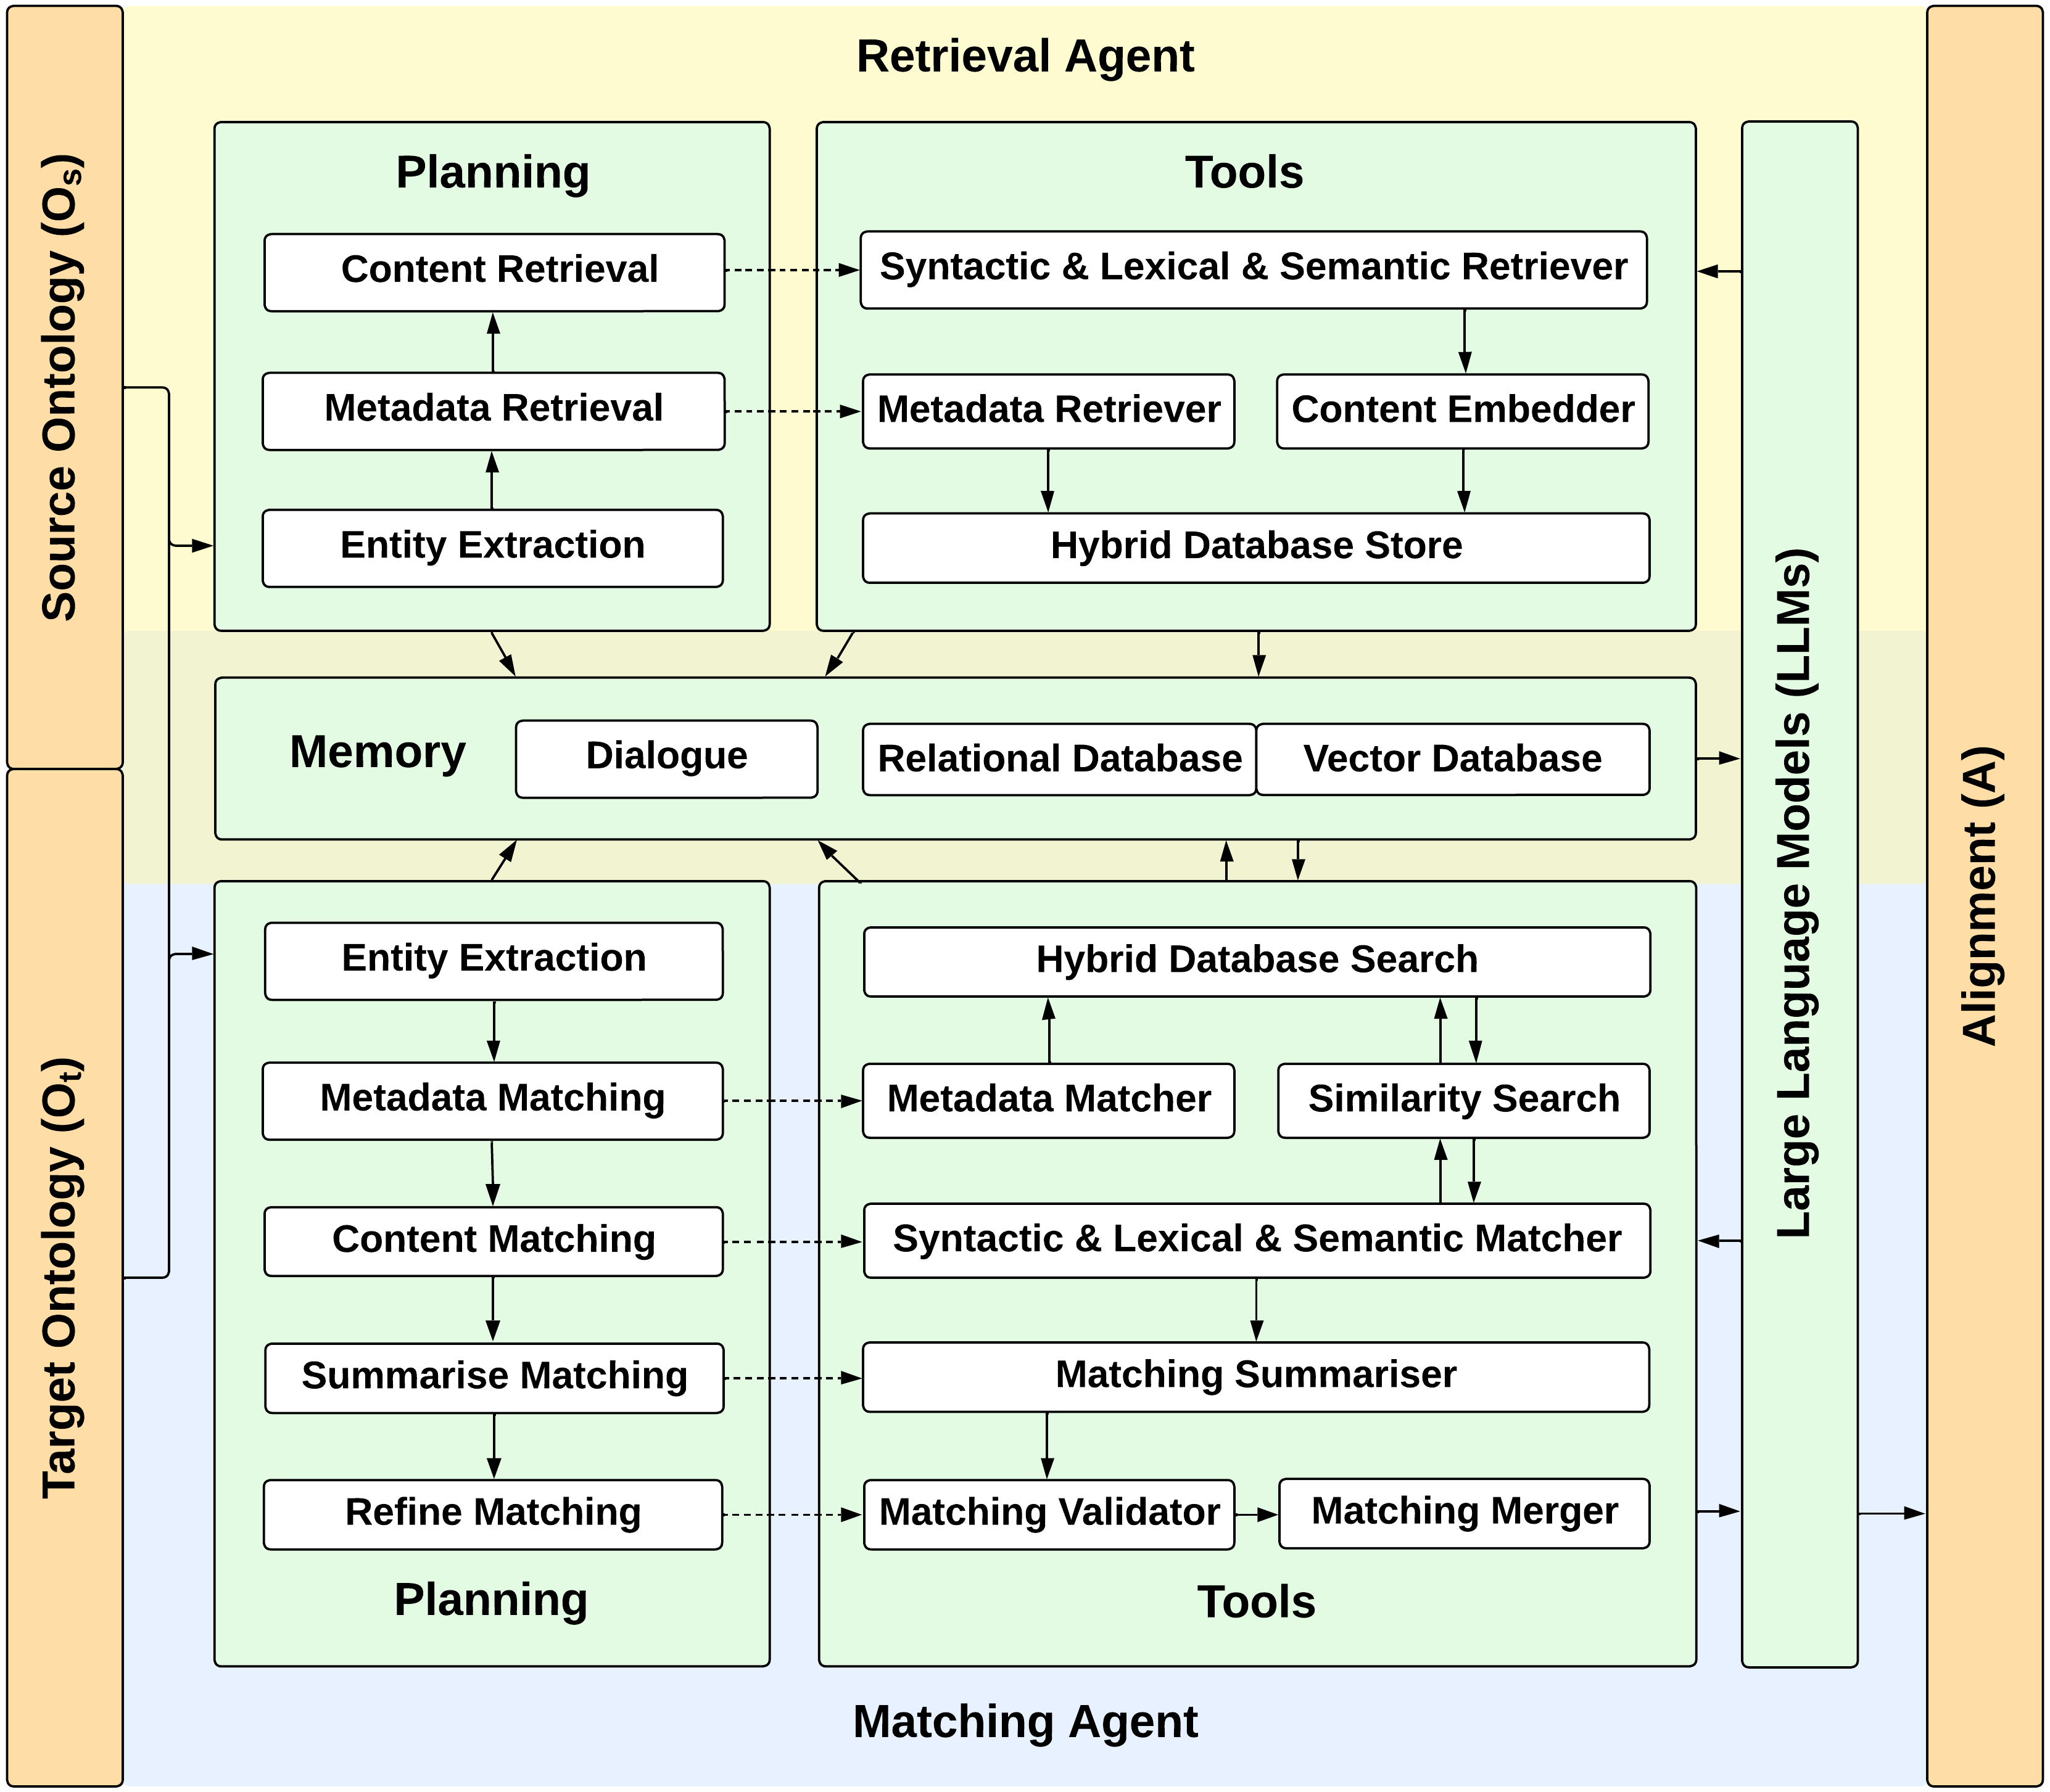
03 Matching with LLM Agents
A classical matching process:
𝑅𝑖𝑛𝑡 ⇒ 𝑅𝑒𝑥𝑡 ⇒ 𝑀𝑠𝑒𝑙 ⇒ 𝑀𝑎𝑙𝑔 ⇒ 𝑀𝑟𝑒f
An agent-based matching process:
𝐴𝑔𝑒𝑛𝑡_𝑅 (𝑅𝑖𝑛𝑡⇒𝑅𝑒𝑥𝑡⇒𝑅𝑠𝑡𝑜)
𝐴𝑔𝑒𝑛𝑡_𝑀 (𝑀𝑠𝑒𝑎⇒𝑀𝑠𝑒𝑙⇒𝑀𝑎𝑙𝑔⇒𝑀𝑟𝑒𝑓)
Abbreviations:
𝑅𝑖𝑛𝑡 = Internal retriever
𝑅𝑒𝑥𝑡 = External retriever
𝑅𝑠𝑡𝑜 = Store information
𝑀𝑠𝑒𝑎 = Search information
𝑀𝑠𝑒𝑙 = Candidate selection
𝑀𝑎𝑙𝑔 = Matching algorithm
𝑀𝑟𝑒f = Matching refinement

Slide 7


Retrieval Agent
Matching Agent
Metadata Retriever (𝑅𝑖𝑛𝑡)
Syntactic Retriever (𝑅𝑖𝑛𝑡)
Lexical Retriever (𝑅𝑖𝑛𝑡 & 𝑅𝑒𝑥𝑡)
Semantic Retriever (𝑅𝑖𝑛𝑡)
Hybrid Database Store with Content Embedder (𝑅𝑠𝑡𝑜)
Hybrid Database Search (𝑀𝑠𝑒𝑎):
Metadata Matcher (𝑀𝑠𝑒𝑙)
Syntactic & Lexical & Semantic Matcher (𝑀𝑠𝑒𝑙)
Matching Summariser (𝑀𝑎𝑙𝑔)
Matching Validator (𝑀𝑟𝑒𝑓)
Matching Merger (𝑀𝑟𝑒𝑓)
Cosine Similarity:
Reciprocal Rank Fusion (RRF):

Slide 8
04 Implementation Details
LLMs:
OpenAI GPT: gpt-4o, gpt-4o-mini
Anthropic Claude: claude-3-sonnet, claude-3-haiku
Mistral AI: mistral-small, mistral-7b
Meta Llama: llama-3-8b
Google Gemma: gemma-2-9b
Alibaba Qwen: qwen-2-7b
Planning:
LangChain Library
Tool Calling Agent
Memory:
Conversational Dialogue
PostgreSQL + pgvector
OpenAI Embedding
Ontology Naming Conventions
Type 1: the name has a natural language meaning
Type 2: the name is a URI or code
Tools:
Prompt-based tools
Programming-based tools
A mixture of above

Slide 9
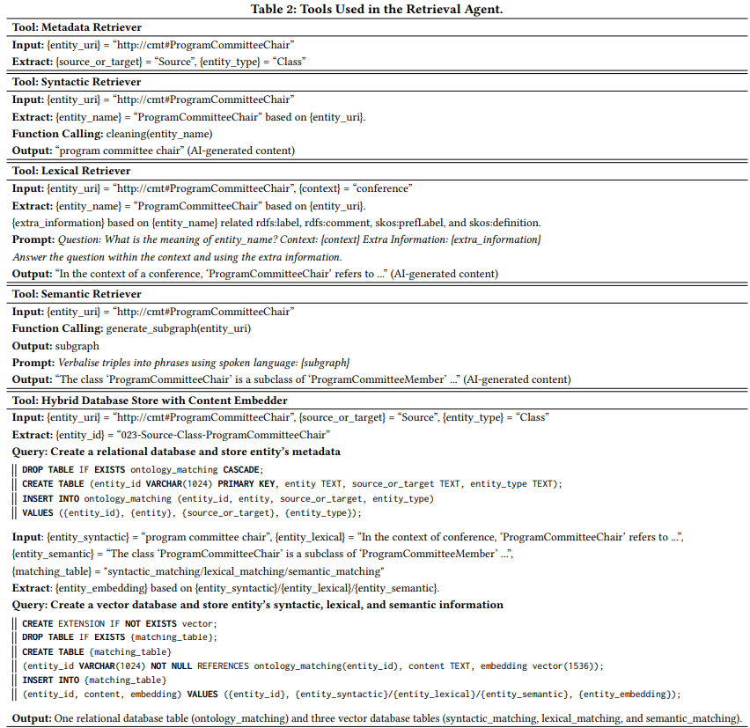
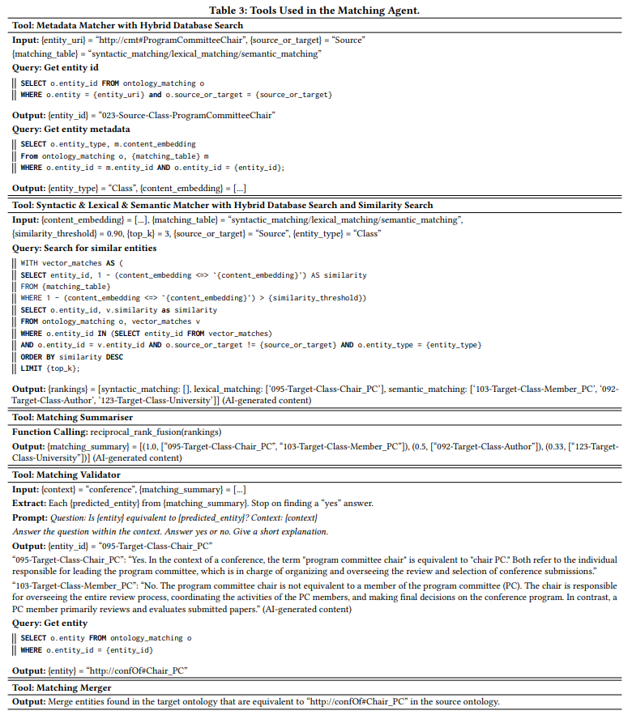
Retrieval Agent
Matching Agent

Slide 10
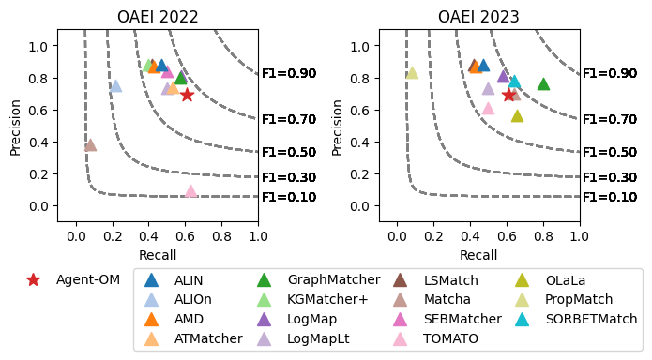
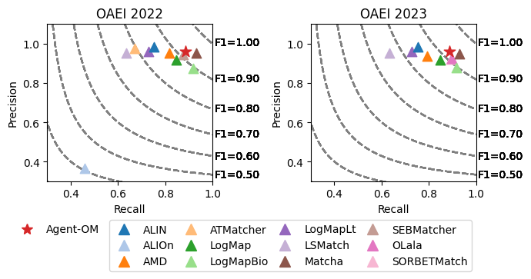
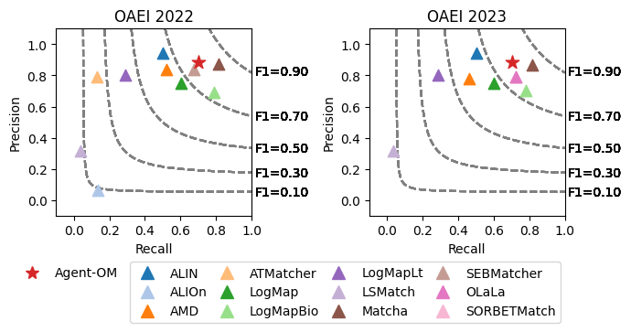
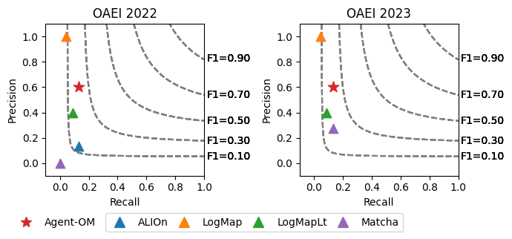
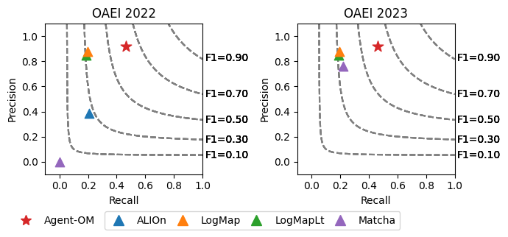
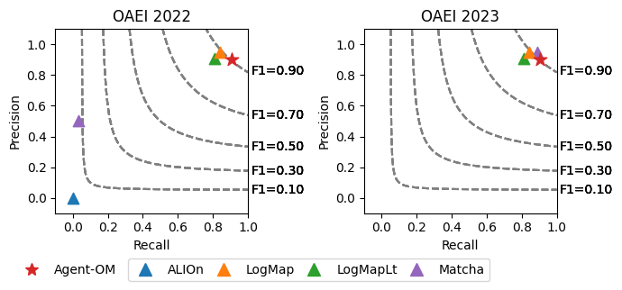
05 Evaluation
OAEI Conference Track
OAEI Anatomy Track
OAEI MSE Track

Slide 11
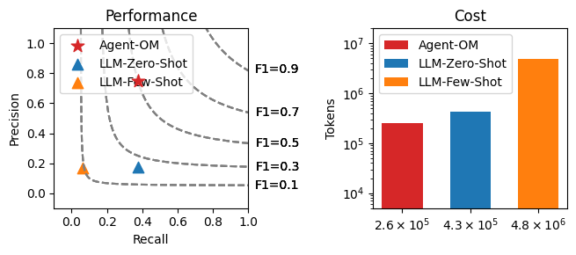
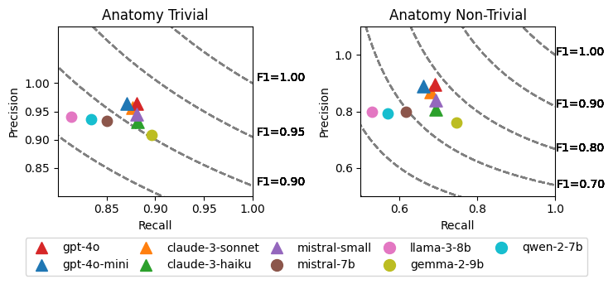
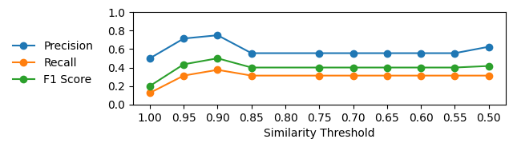
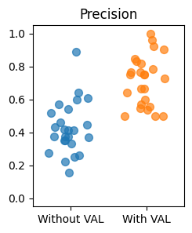
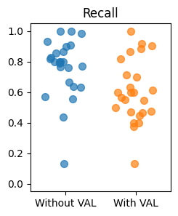
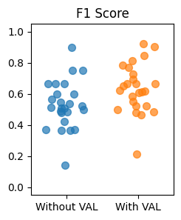
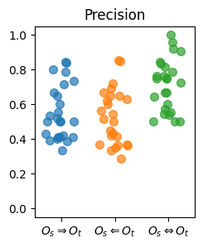
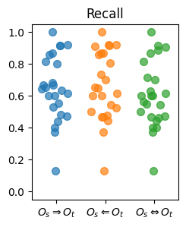
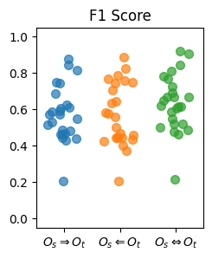
05 Ablation Study
Comparison of different similarity thresholds.
Comparison of LLM-based architectures.
Comparison of different LLMs.
Comparison of without/with matching validator.
Comparison of 𝑂𝑠 ⇒ 𝑂𝑡, 𝑂𝑡 ⇐ 𝑂𝑠 , and 𝑂𝑠 ⇔ 𝑂t.

Slide 12
06 Discussion
Findings:
Agent-based OM is more efficient than LLM-based OM.
Agent-based OM is more effective than LLM-based OM.
Advantages: Context Learning, Transitive Reasoning, Self Correction.
Implications:
A matching process could be more complex.
Prompt engineering is the key to instructing efficient LLM agents.
LLM hallucinations can be mitigated, but cannot be eliminated.
There is a trade-off between precision and recall.
Moravec’s paradox: “hard problems are easy and the easy problems are hard.”

Slide 13
06 Limitations
Limitations:
We evaluate only the T-Box matching datasets that focus on matching between named classes, object properties, and data type properties. A-Box matching datasets (including individual data instances) are not considered due to privacy concerns in our targeted application domain.
Due to the high cost of API calls for API-accessed commercial LLMs, experiments with the newest commercial models (e.g. gpt4-turbo, claude-3-opus, and mistral-large) are not included in this study.
There may be additional resource requirements for running open-source LLMs locally. The run time for API-accessed commercial LLMs is controlled by the LLM providers.
Future work:
Multimodal OM
Multilinguistic OM
Small language model (SLM) for OM

Slide 14
References
[1] Ernesto Jiménez-Ruiz and Bernardo Cuenca Grau. 2011. LogMap: Logic-Based and Scalable Ontology Matching. ISWC 2011. Springer, Berlin, Heidelberg, 273–288. https://doi.org/10.1007/978-3-642-25073-6_18
[2] Ernesto Jiménez-Ruiz, Bernardo Cuenca Grau, and Yujiao Zhou. 2011. LogMap 2.0: Towards Logic-Based, Scalable and Interactive Ontology Matching. In Proceedings of the 4th International Workshop on Semantic Web Applications and Tools for the Life Sciences (London, United Kingdom) (SWAT4LS ’11). Association for Computing Machinery, New York, NY, USA, 45–46. https://doi.org/10.1145/2166896.2166911
[3] Daniel Faria, Catia Pesquita, Emanuel Santos, Isabel F Cruz, and Francisco M Couto. 2014. AgreementMakerLight 2.0: Towards Efficient Large-Scale Ontology Matching. In ISWC (Posters & Demos). Springer International Publishing, Cham, 457–460.
[4] Daniel Faria, Catia Pesquita, Emanuel Santos, Matteo Palmonari, Isabel F. Cruz, and Francisco M Couto. 2013. The AgreementMakerLight Ontology Matching System. In On the Move to Meaningful Internet Systems: OTM 2013 Conferences. Springer, Berlin, Heidelberg, 527–541. https://doi.org/10.1007/978-3-642-41030-7_38
[5] Guoxuan Li, Songmao Zhang, Jiayi Wei, and Wenqian Ye. 2021. Combining FCA-Map with representation learning for aligning large biomedical ontologies. In OM@ISWC. Springer, Berlin, Heidelberg, 207–208.
[6] Mengyi Zhao, Songmao Zhang, Weizhuo Li, and Guowei Chen. 2018. Matching biomedical ontologies based on formal concept analysis. Journal of biomedical semantics 9, 1 (2018), 1–27. https://doi.org/10.1186/s13326-018-0178-9
[7] Yuan He, Jiaoyan Chen, Denvar Antonyrajah, and Ian Horrocks. 2022. BERTMap: A BERT-based Ontology Alignment System. arXiv:2112.02682 [cs.AI]
[8] Jiaoyan Chen, Ernesto Jiménez-Ruiz, Ian Horrocks, Denvar Antonyrajah, Ali Hadian, and Jaehun Lee. 2021. Augmenting Ontology Alignment by Semantic Embedding and Distant Supervision. In The Semantic Web. Springer International Publishing, Cham, 392–408. https://doi.org/10.1007/978-3-030-77385-4_23
[9] Jonathan Fürst, Mauricio Fadel Argerich, and Bin Cheng. 2023. VersaMatch: Ontology Matching with Weak Supervision. Proc. VLDB Endow. 16, 6 (feb 2023), 1305–1318. https://doi.org/10.14778/3583140.3583148
[10] Yuan He, Jiaoyan Chen, Hang Dong, and Ian Horrocks. 2023. Exploring Large Language Models for Ontology Alignment. arXiv:2309.07172 [cs.AI]
[11] Sanaz Saki Norouzi, Mohammad Saeid Mahdavinejad, and Pascal Hitzler. 2023. Conversational Ontology Alignment with ChatGPT. arXiv:2308.09217 [cs.CL]
[12] Sven Hertling and Heiko Paulheim. 2023. OLaLa: Ontology Matching with Large Language Models. arXiv:arXiv:2311.03837 [cs.IR]
[13] Hamed Babaei Giglou, Jennifer D’Souza, Felix Engel, and Sören Auer. 2024. LLMs4OM: Matching Ontologies with Large Language Models. arXiv:2404.10317 [cs.AI]
[14] Reihaneh Amini, Sanaz Saki Norouzi, Pascal Hitzler, and Reza Amini. 2024. Towards Complex Ontology Alignment using Large Language Models. arXiv:2404.10329 [cs.AI]
[15] Hamed Babaei Giglou, Jennifer D’Souza, and Sören Auer. 2023. LLMs4OL: Large Language Models for Ontology Learning. arXiv:2307.16648 [cs.AI]
[16] Bohui Zhang, Valentina Anita Carriero, Katrin Schreiberhuber, Stefani Tsaneva, Lucía Sánchez González, Jongmo Kim, and Jacopo de Berardinis. 2024. OntoChat: a Framework for Conversational Ontology Engineering using Language Models. arXiv:2403.05921 [cs.AI]
[17] Shiyao Zhang, Yuji Dong, Yichuan Zhang, Terry R Payne, and Jie Zhang. 2024. Large Language Model Assisted Multi-Agent Dialogue for Ontology Alignment. AAMAS ’24.
[18] Terry R. Payne and Valentina Tamma. 2014. Negotiating over ontological correspondences with asymmetric and incomplete knowledge. AAMAS ’14. https://doi.org/10.5555/2615731.2615816

Slide 15
Q & A
Thank you.
Any questions?
Contact Information
Zhangcheng Qiang: qzc438@gmail.com
Weiqing Wang: teresa.wang@monash.edu
Kerry Taylor: kerry.taylor@anu.edu.au

